Slide 1
RECURSION

Slide 2
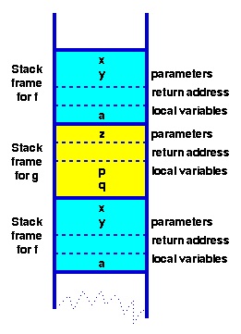
Activation Records

Slide 3
Recursive Functions
Recursion is a very powerful algorithm design tool.
A subprogram is called recursive if it directly or indirectly calls it self.
The end condition specifies where to stop.
With each recursive step you should come closer to the end condition.
In other words, with a recursive step, you apply the same algorithm on a scaled down problem and its process is repeated until the end of condition is reached.
A recursive program has two parts:
The End Condition.
The Recursive Step.

Slide 4
How Does Recursion Work Some More Recursive Functions and Their Simulation
int factorial (int n)
{
int temp;
if (n<0) return 0; //end condition
else if (n <=1) return 1; //end condition
else {
temp = factorial(n-1); //recursive step
return n*temp;
}
}

Slide 5
Simulation of factorial(4)
n = 4
n = 3
1.
2. return 1
n = 2
1.
2. return 1
n = 1
1.
2. return 1
1.
2.
3.
4.
1.
2.
3.
4.
1.
2.
3.
4.
1.
2. return 1
temp = 6
5. return 4*6
temp = 2
5. return 3*2
temp = 1
5. return 2*1
if (n<0) return 0;
else if (n <=1) return 1;
else {
temp = factorial (n-1);
return n*temp;
}

Slide 6
Fibonacci Sequence 0,1,1,2,3,5,8,13,…
int fibonacci (int n)
{
int temp1, temp2;
if (n<=0) return 0; //end condition
else if (n<=2) return 1; //end condition
else{
temp1 = fibonacci(n - 1); // recursive step
temp2 = fibonacci(n - 2); //recursive step
return temp1 + temp2; //same as return fib(N-1)+fib(N-2)
}
}

Slide 7
Simulation of fibonacci(4)
n = 3
n = 2
1.
2. return 1
n = 2
1.
2. return 1
n = 1
1.
2. return 1
1.
2.
3.
1.
2. return 1
1.
return 1
1.
2. return 1
temp1 = 1
4.
temp2 = 1
5. return 2
if (n<=0) return 0;
else if (n<=2) return 1;
else {
temp1 = fibonacci(n - 1);
temp2 = fibonacci(n - 2);
return temp1 + temp2;
}

